Slide 1
Multiple linear regression

Slide 2
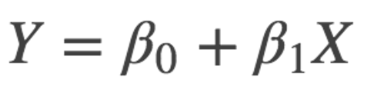
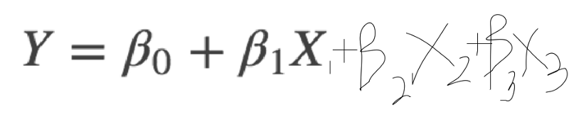
Multiple Linear Regression
Its Simple Linear Regression, but with more Relationships
Becomes
The multiple linear regression explains the relationship between:
One continuous dependent variable (y) and
Two or more independent variables (x1, x2, x3… etc)
Notes:
https://diamondage.com/2017/06/03/what-does-it-mean-to-fit-a-model-anyway/

Slide 3
The Data
Note that in the wild, when you do encounter a dataset, it is going to be ugly.
It’s going to have
missing values,
erroneous entries,
wrongly formatted columns,
irrelevant variables… etc
You’ll need to
Select good features,
Try different algorithms

Slide 4
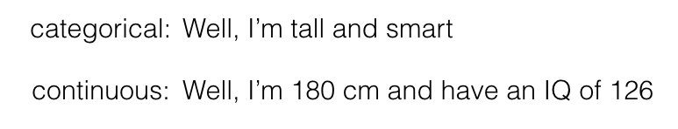
Categorical Variables >>> Continuous Variables
Due to the nature of the regression equation, your x variables have to be continuous as well.
Thus, you’ll need to look into changing your categorical variables into continuous ones.
Continuous variables are running numbers.
Categorical variables are categories.

Slide 5
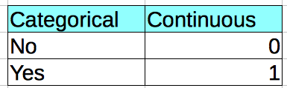

How to deal with Categorical Variables
Label Encoder
One Hot Encoding

Slide 6
Feature Selection
Having too many variables could potentially cause your model to become less accurate
Certain variables have no effect on the outcome or have a significant effect on other variables.
Basic step of Feature Selection:
Use your Common and/or Business Sense(s)
One other way to select features is to use the p-values.
P-values tell you how statistically significant the variable is.
This action of omitting variables is part of stepwise regression. There are 3 ways to do this:
Forward Selection
Backward Elimination
Bidirectional Elimination

Slide 7

Feature Scaling
Is a method used to standardize the range of independent variables or features of data.
It is a step of Data Pre Processing which is applied to independent variables.
It helps to normalize the data within a particular range.
It also helps in speeding up the calculations in an algorithm.

Slide 8
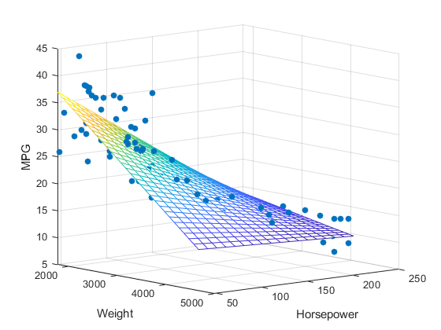
Multiple Linear Regression
Finally using the same we will find out the intercept and coefficient.
Here we will have multiple coefficient – one for each input feature.

Slide 9
Thanks

